Slide 1
Data Programming in R Group Project > R gang
> Kristine Arens
> Cody Burger
> Michelle Cutlip
> Ben Huntington
> Matthew Pelham
Notes:
Michelle - introductions

Slide 2
Project overview
The Situation > Which factors contribute to a post-secondary school’s student loan default rates?
What geographic areas have the highest and lowest default rates
Correlations between school type and default rate
Influence of cost of attendance on default rate
Use of the Data > U.S. Department of Education's Plan and Policy Development Guidance for Public Access
Notes:
Michelle
Situation:
Analyze data from post-secondary institutions which means programs eligible for Federal Funding. This included schools such as vocational/technical training up through a public or private college institutions. Non-degree (0-3 years), associates, masters, PhD.
Data:
Initial dataset was from US Department of Education Federal Student Aid (default data)
Data was organized by school, each with an OPEID
Peps300 dataset
# students in default, rate type, ethnic affiliation of school, school location
To strengthen data, located other data about schools on National Center for Education Statistics
Various datasets organized by school
Chose 3 datasets – each with many variables but interested in only
Attendance
Latitude and longitude
Cost
Downloaded datasets (3 years x 3 datasets)
Combined into one Excel spreadsheet pulling in only columns of interest
Each subset and year was put on it’s own sheet in IPEDS full dataset

Slide 3
The Data
The Data > Department of Education’s Federal Student Aid
School default rate
School type
Program length
School ethnic affiliation
Number of students in default
Number of students in repayment
> National Center for Education Statistics
School longitude and latitude coordinates
School attendance numbers
School tuition and fees
Aligning the Data > OPEID vs. UNITID
Notes:
Michelle
Program length: Everything from non-degree programs up through institutions offering PhD degrees

Slide 4
Project challenges
Locating school data
Finding table to sync OPEID and UNITID
Discovery downstream that default data was only a subset
Streamlining correspondence and splitting the work breakdown
Notes:
Michelle
Employer not willing to allow use

Slide 5
Importing and combining the data
Function
Joining the dataframes
Notes:
Matt
Discuss function to pull in data and join the dataframes
Each of the 3 types of analyses code were created, and wrapped into separate functions
Challenges in setting this up

Slide 6
Cleaning the data
Notes:
Matt

Slide 7
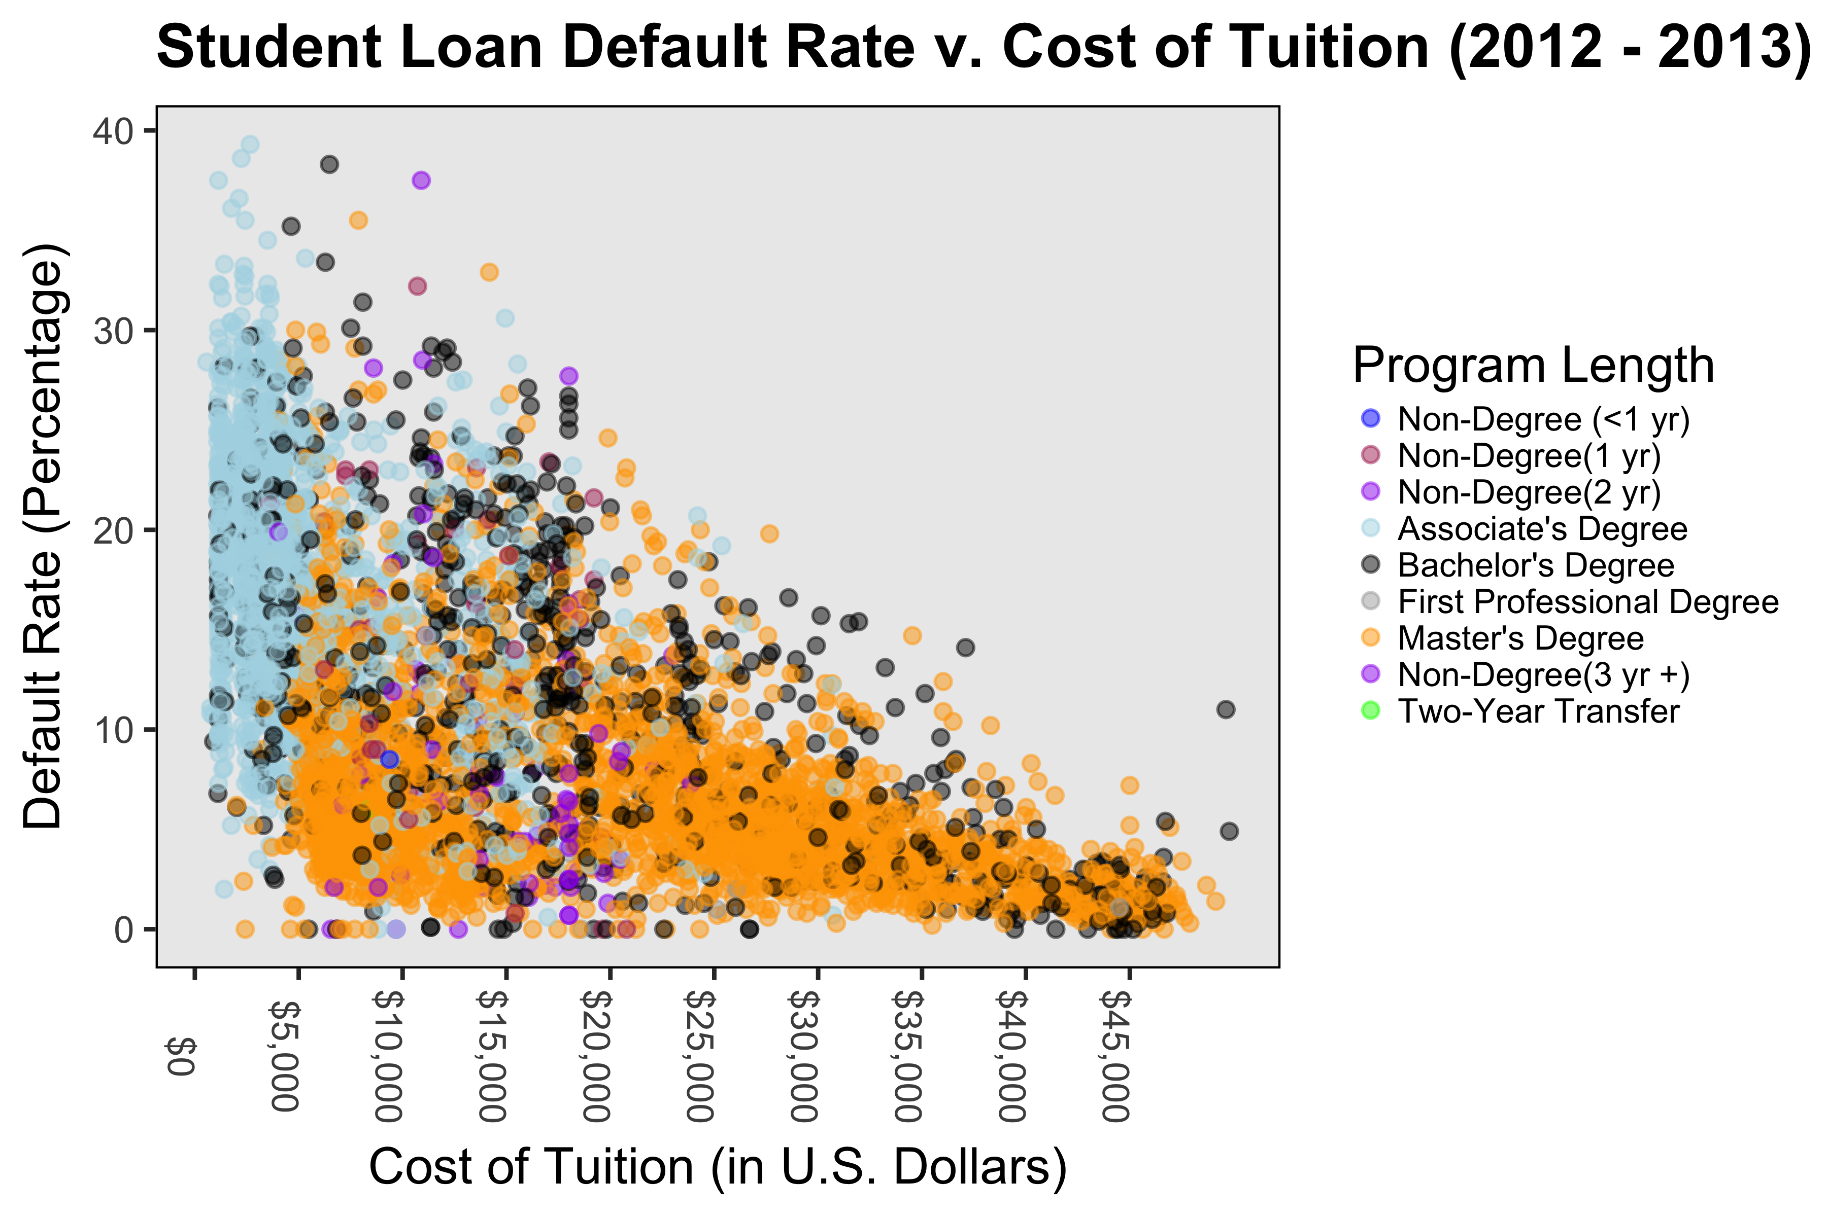
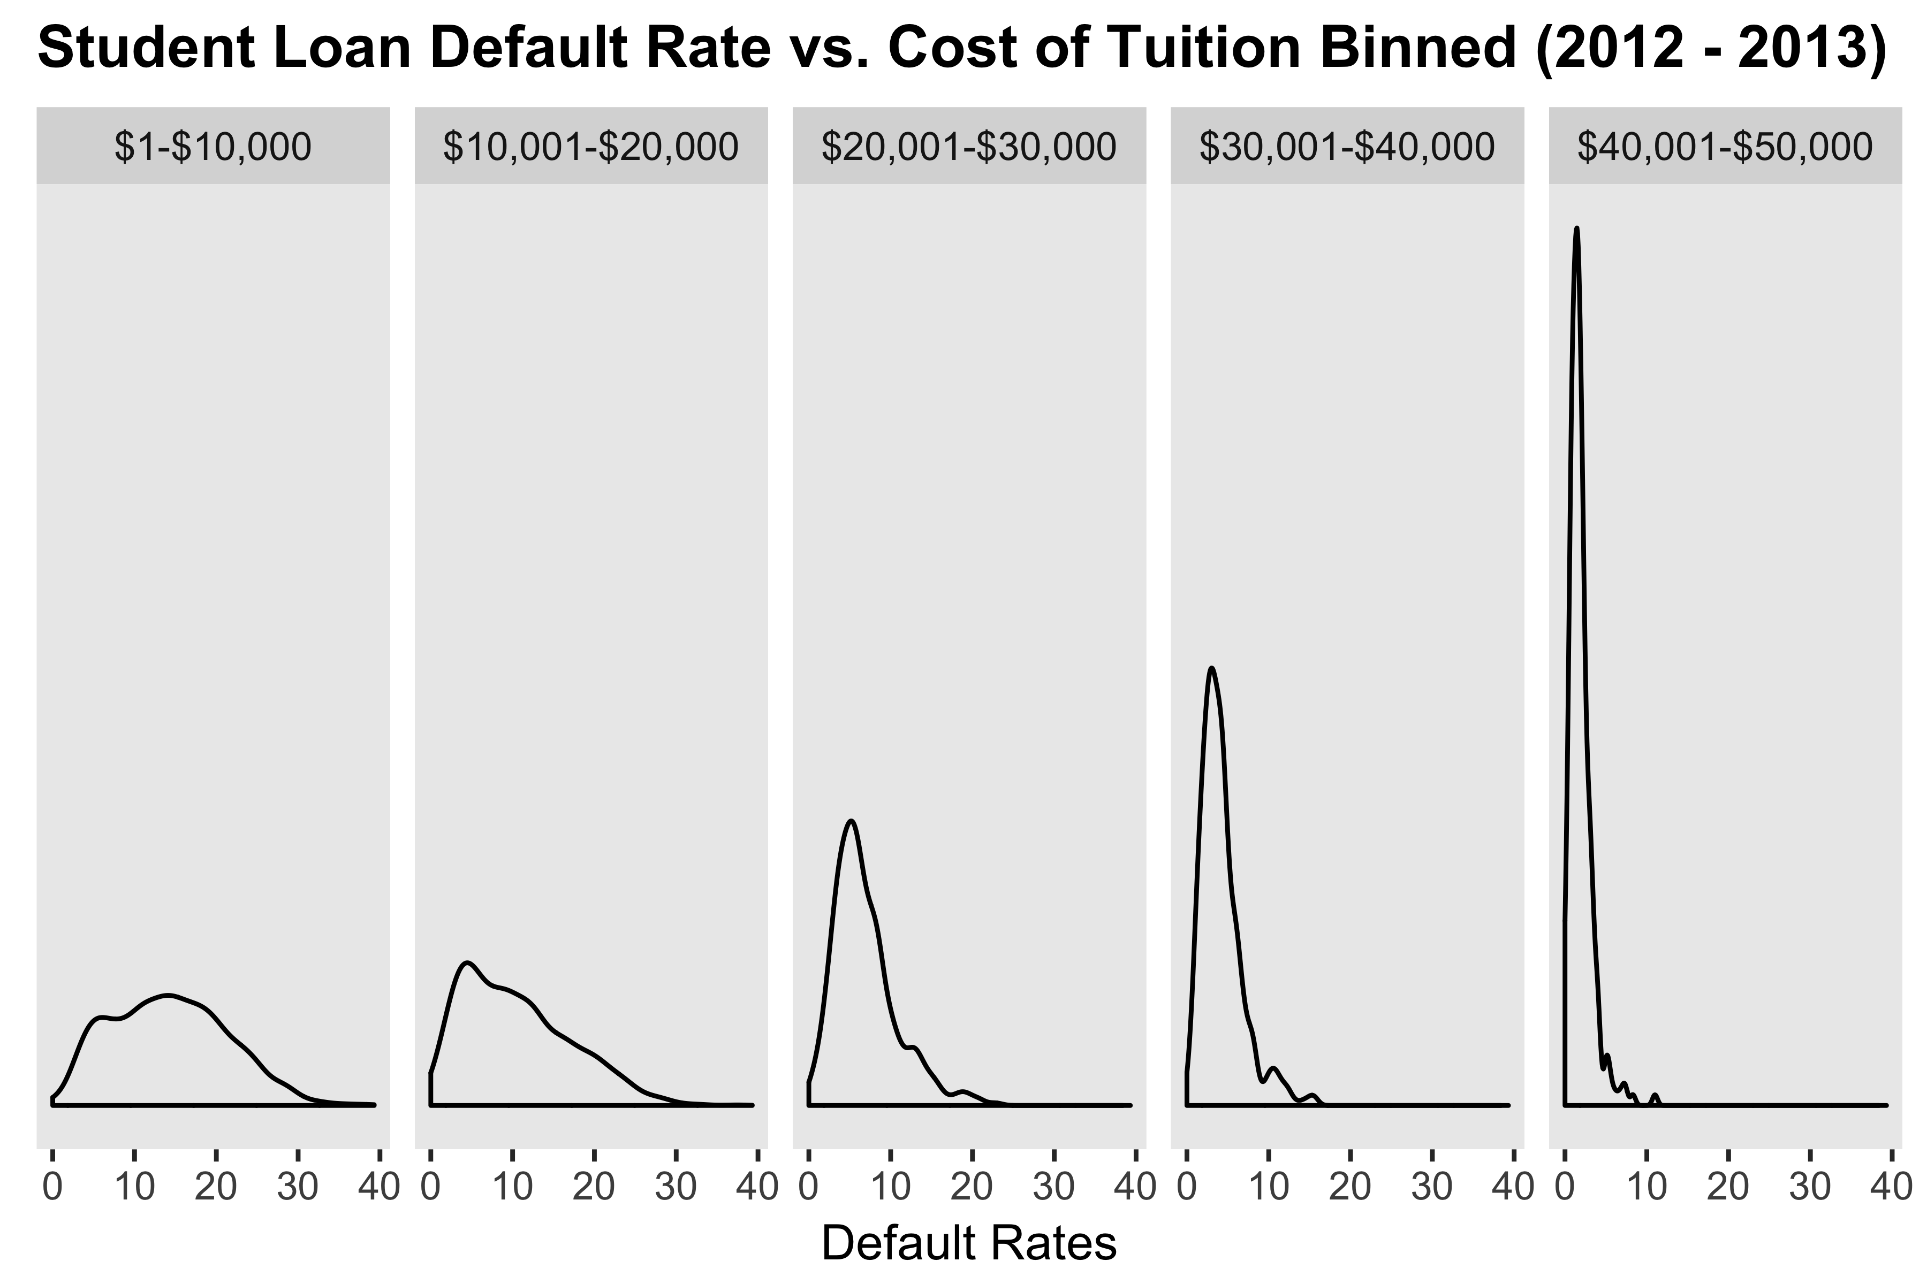
Default Rate on Cost of tuition measured by: program length
Notes:
Cody

Slide 8
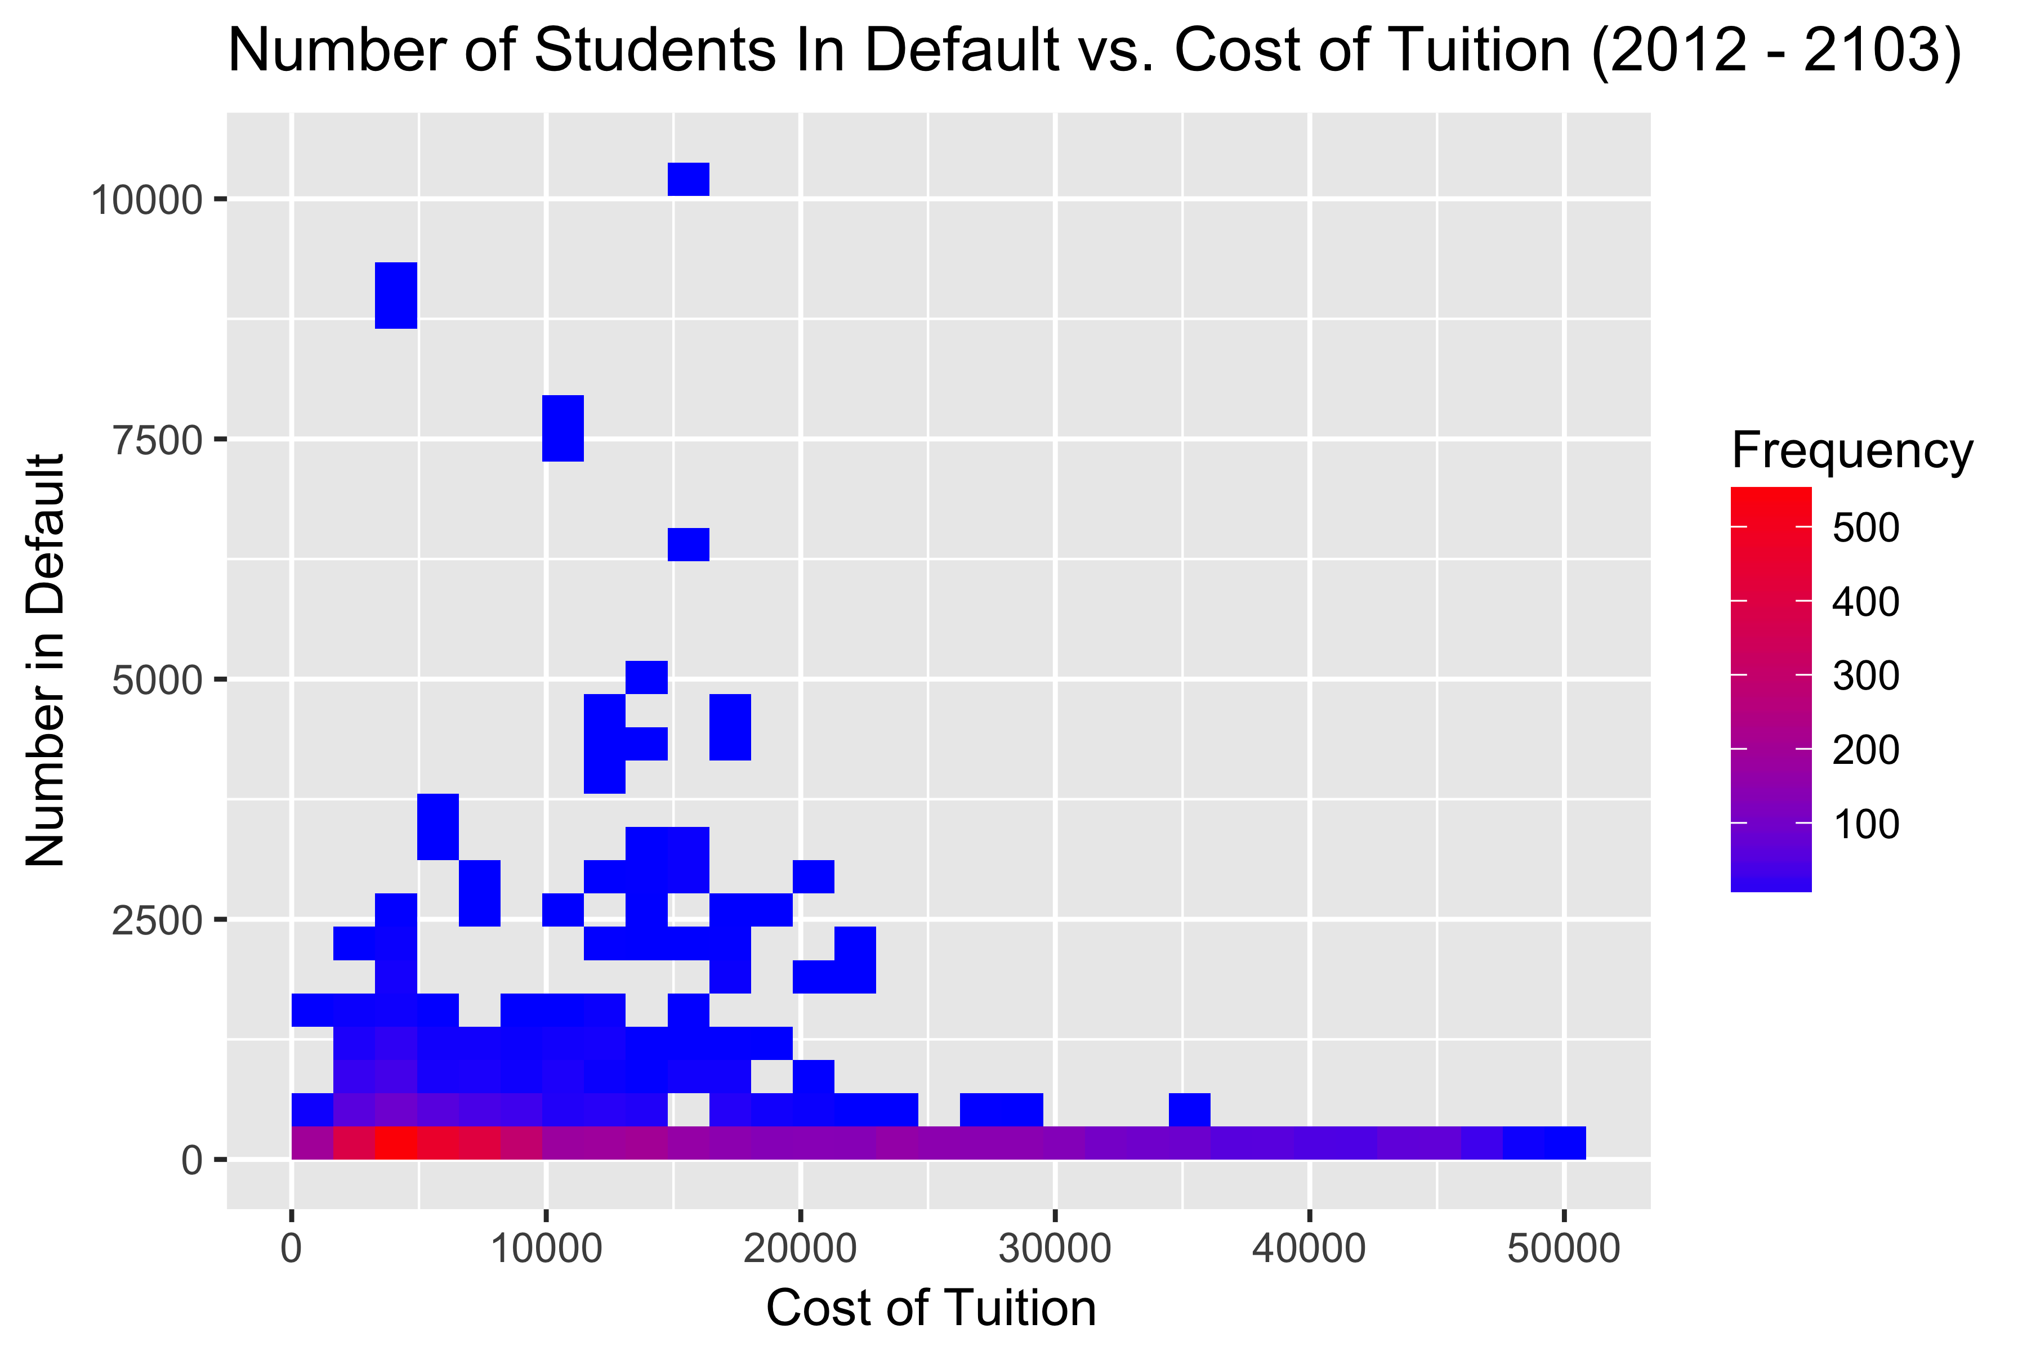
Density plot outlining number of students in default on cost of tuition
Notes:
Cody

Slide 9
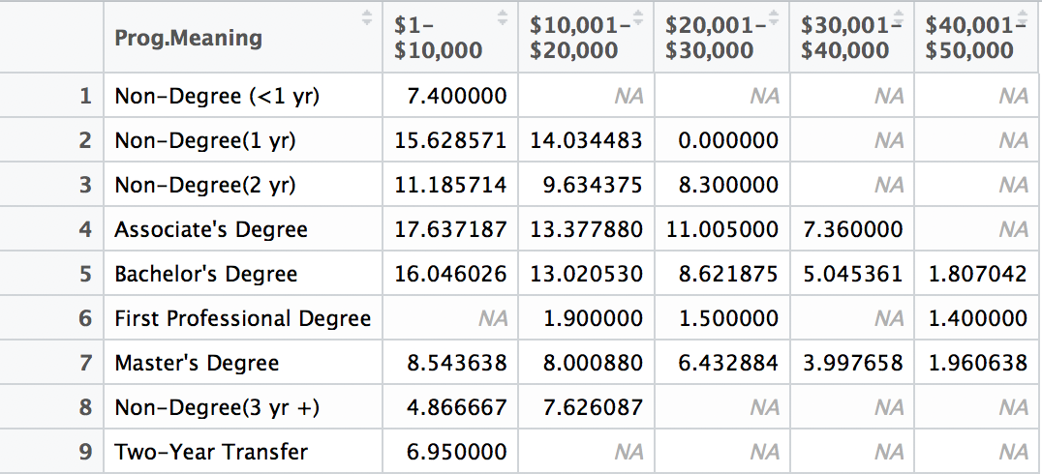
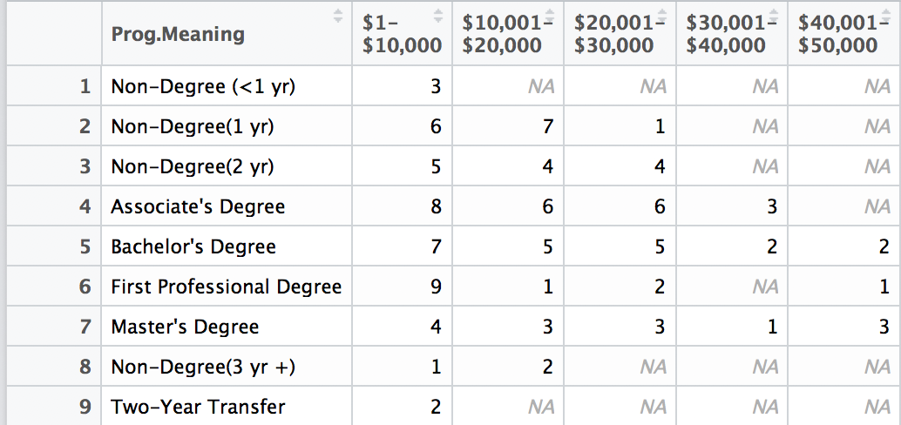
Default Rates(summary tables
Notes:
Cody

Slide 10
Analysis 1 - graph
Notes:
Ben

Slide 11
Analysis 2 – r script
Notes:
Ben

Slide 12
Analysis 2 - graph
Notes:
Ben

Slide 13
Analysis 3 – R script Default loan rate by location
GOAL: Plot (using longitude and latitude) default rates by location for US, a given state and year
CONSIDERATIONS:
CohortDefault Rate - Range of default rates (0 – 39.3) skews results, removed results 0 – 5%
Year – Two years of data, reduce map to just one year of data
Longitude and Latitude – Retain only the contiguous 48 states data
State – Allow for ability to map just one state
Notes:
Kris

Slide 14
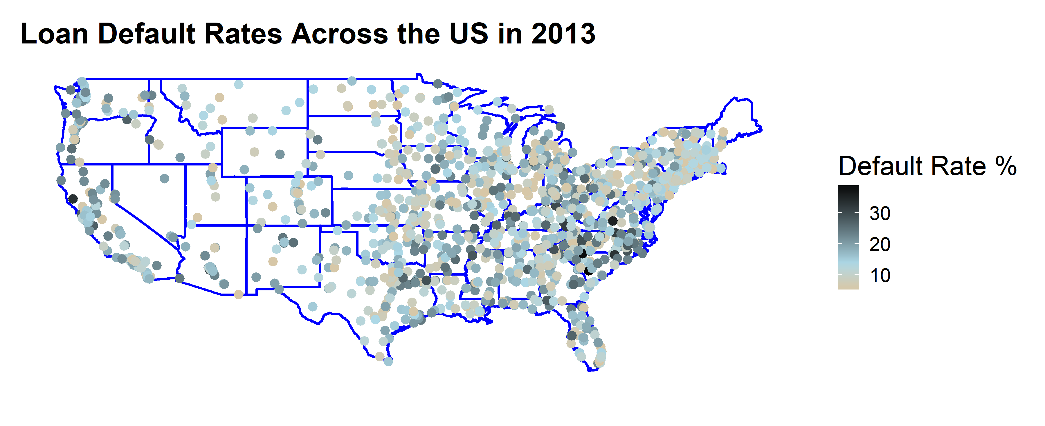
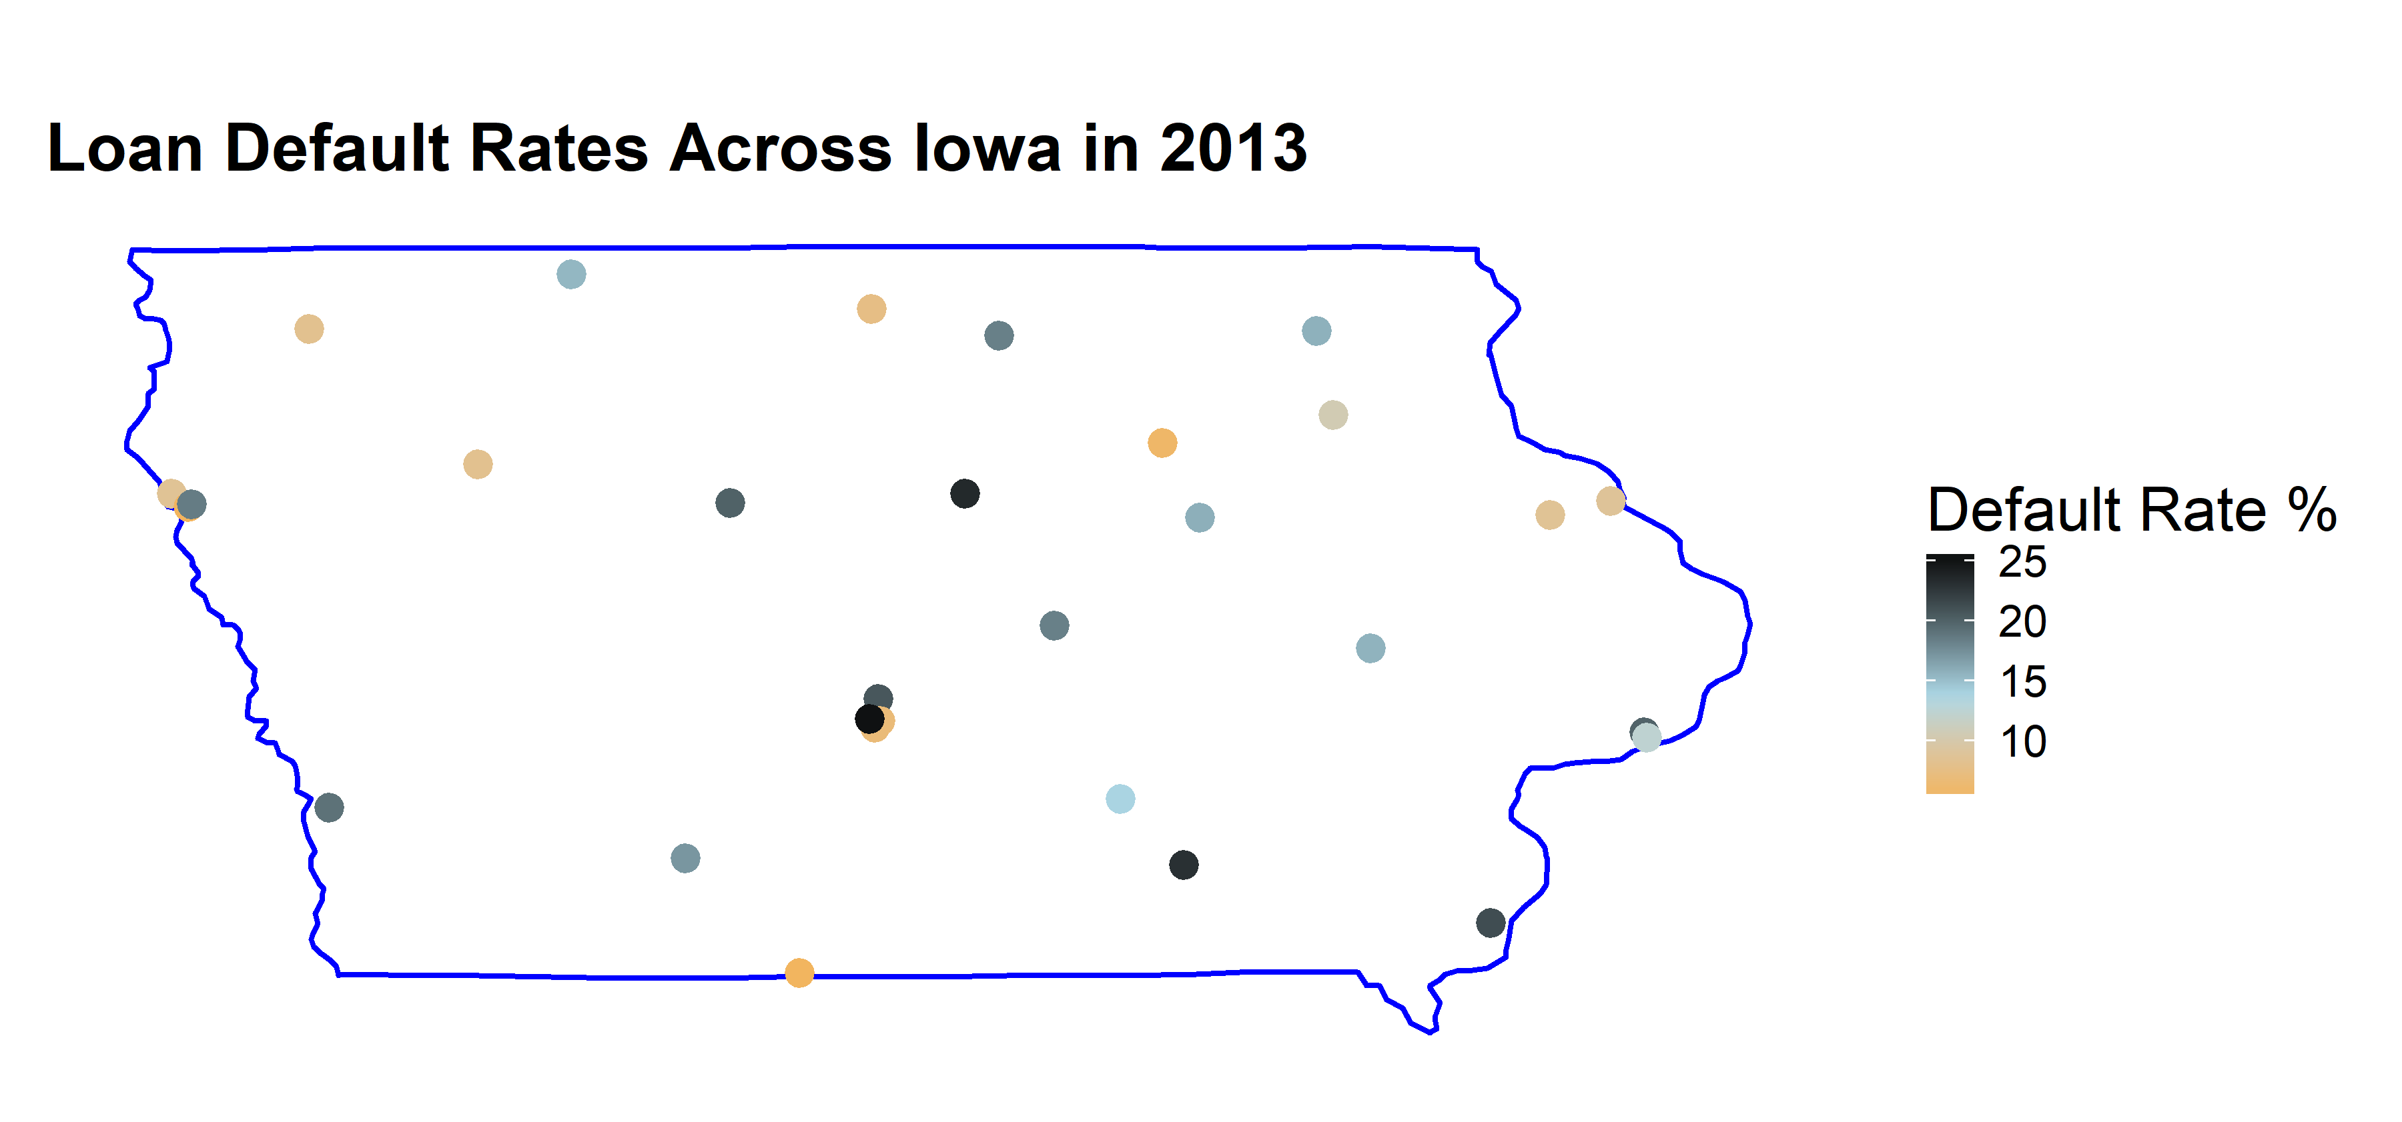
Analysis 3 – graph DEFAULT RATE BY LOCATION
Notes:
Kris

